Slide 1

Exception Handling
Handling Errors During the Program Execution
SoftUni Team
Technical Trainers
Software University
http://softuni.bg

Slide 2
Table of Contents
What are Exceptions?
The System.Exception Class
Types of Exceptions and their Hierarchy
Handling Exceptions
Raising (Throwing) Exceptions
Best Practices
Creating Custom Exceptions

Slide 3
Have a Question?
sli.do
#fund-csharp

Slide 4

What are Exceptions?
The Paradigm of Exceptions in OOP

Slide 5
What are Exceptions?
Simplify code construction and maintenance
Allow the problematic situations to be processed at multiple levels
Exception objects have detailed information about the error
There are two ways to write error-free programs; only the third one works. (Alan J. Perlis)

Slide 6
The System.Exception Class
Exceptions in C# are objects
The System.Exception class is a base for all
exceptions in CLR
Contains information for the cause of the error
Message – a text description of the exception
StackTrace – the snapshot of the stack at the
moment of exception throwing
InnerException – exception that caused the current exception (if any)

Slide 7
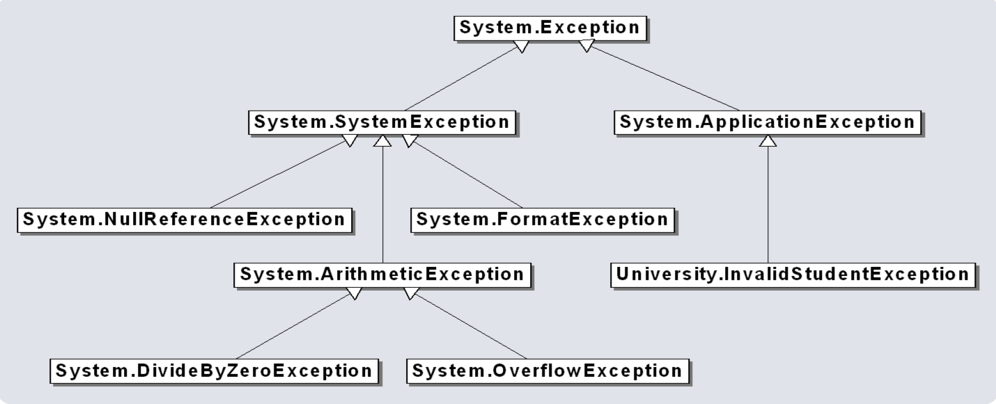
Exception Hierarchy in .NET
Exceptions in .NET Framework are organized in a
hierarchy

Slide 8
Types of Exceptions
.NET exceptions inherit from System.Exception
The system exceptions inherit from System.SystemException
System.ArgumentException
System.FormatException
System.NullReferenceException
System.OutOfMemoryException
System.StackOverflowException
User-defined exceptions should inherit from System.Exception

Slide 9

Handling Exceptions
Catching and Processing Errors

Slide 10

Handling Exceptions
In C# exceptions can be handled by the try-catch-finally construction
catch blocks can be used multiple times to process different exception types
try
{
// Do some work that can raise an exception
}
catch (SomeException)
{
// Handle the caught exception
}

Slide 11
Multiple Catch Blocks – Example
string s = Console.ReadLine();
try
{
int.Parse(s);
Console.WriteLine(
"You entered a valid Int32 number {0}.", s);
}
catch (FormatException)
{
Console.WriteLine("Invalid integer number!");
}
catch (OverflowException)
{
Console.WriteLine(
"The number is too big to fit in Int32!");
}

Slide 12

Handling Exceptions
When catching an exception of a particular class, all its inheritors
(child exceptions) are caught too, e.g.
Handles ArithmeticException and its descendants DivideByZeroException and OverflowException
try
{
// Do some work that can cause an exception
}
catch (ArithmeticException ae)
{
// Handle the caught arithmetic exception
}

Slide 13
Find the Mistake!
string str = Console.ReadLine();
try
{
Int32.Parse(str);
}
catch (Exception)
{
Console.WriteLine("Cannot parse the number!");
}
catch (FormatException)
{
Console.WriteLine("Invalid integer number!");
}
catch (OverflowException)
{
Console.WriteLine(
"The number is too big to fit in Int32!");
}
Should be last
Unreachable code
Unreachable code

Slide 14
Handling All Exceptions
Unmanaged code can throw other exceptions
For handling all exceptions (even unmanaged) use the construction:
try
{
// Do some work that can raise any exception
}
catch (Exception ex)
{
// Handle the caught exception
}

Slide 15
The try-finally Statement
The statement:
Ensures execution of a given block in all cases
When exception is raised or not in the try block
Used for execution of cleaning-up code, e.g. releasing resources
try
{
// Do some work that can cause an exception
}
finally
{
// This block will always execute
}

Slide 16
try-finally – Example
static void TestTryFinally()
{
Console.WriteLine("Code executed before try-finally.");
try {
string str = Console.ReadLine();
int.Parse(str);
Console.WriteLine("Parsing was successful.");
return; // Exit from the current method
}
catch (FormatException) {
Console.WriteLine("Parsing failed!");
}
finally {
Console.WriteLine("This cleanup code is always executed.");
}
Console.WriteLine("This code is after the try-finally block.");
}

Slide 17
How Do Exceptions Work?
try
Run this code
catch
Execute this code when there is an exception
finally
Always run this code

Slide 18

Handling Exceptions
Live Demo

Slide 19

Throwing Exceptions

Slide 20
Throwing Exceptions
Exceptions are thrown (raised) by the throw keyword
Used to notify the calling code in case of an error or unusual situation
When an exception is thrown:
The program execution stops
The exception travels over the stack
Until a matching catch block is reached to handle it
Unhandled exceptions display an error message

Slide 21
Using throw Keyword
Throwing an exception with an error message:
Exceptions can accept message and cause:
Note: if the original exception is not passed, the initial cause of the exception is lost
throw new ArgumentException("Invalid amount!");
try
{
…
}
catch (SqlException sqlEx)
{
throw new InvalidOperationException("Cannot save invoice.", sqlEx);
}

Slide 22
Re-Throwing Exceptions
Caught exceptions can be re-thrown again:
try
{
Int32.Parse(str);
}
catch (FormatException fe)
{
Console.WriteLine("Parse failed!");
throw fe; // Re-throw the caught exception
}
catch (FormatException)
{
throw; // Re-throws the last caught exception
}

Slide 23
Throwing Exceptions – Example
public static double Sqrt(double value)
{
if (value < 0)
throw new System.ArgumentOutOfRangeException("value",
"Sqrt for negative numbers is undefined!");
return Math.Sqrt(value);
}
static void Main()
{
try
{
Sqrt(-1);
}
catch (ArgumentOutOfRangeException ex)
{
Console.Error.WriteLine("Error: " + ex.Message);
throw;
}
}

Slide 24

Throwing Exceptions
Live Demo

Slide 25

Best Practices

Slide 26
Using catch block
Catch blocks should:
Begin with the exceptions lowest in the hierarchy
Continue with the more general exceptions
Otherwise a compilation error will occur
Each catch block should handle only these exceptions which it expects
If a method is not competent to handle an exception, it should leave it unhandled
Handling all exceptions disregarding their type is a popular bad practice (anti-pattern)!

Slide 27
Choosing the Exception Type
When an invalid parameter value is passed to a method:
ArgumentException, ArgumentNullException, ArgumentOutOfRangeException
When requested operation is not supported
NotSupportedException
When a method is still not implemented
NotImplementedException
If no suitable standard exception class is available
Create own exception class (inherit Exception)

Slide 28


Exceptions – Best Practices
When raising an exception, always pass to the constructor a good
explanation message
When throwing an exception always pass a good description of the
problem
The exception message should explain what causes the problem and how to solve it
Good: "Size should be integer in range [1…15]"
Good: "Invalid state. First call Initialize()"
Bad: "Unexpected error"
Bad: "Invalid argument"

Slide 29
Exceptions – Best Practices (2)
Exceptions can decrease the application performance
Throw exceptions only in situations which are really exceptional and should be handled
Do not throw exceptions in the normal program control flow
CLR could throw exceptions at any time with no way to predict them
E.g. System.OutOfMemoryException

Slide 30
Creating Custom Exceptions
Custom exceptions inherit an exception class (commonly – System.Exception)
Thrown just like any other exception
public class TankException : Exception
{
public TankException(string msg)
: base(msg) { … }
}
throw new TankException("Not enough fuel to travel");

Slide 31

Summary
…
…
…
Exceptions provide a flexible error handling mechanism
Unhandled exceptions cause error messages
Try-finally ensures a given code block is always executed
Even when an exception is thrown

Slide 32
https://softuni.bg/courses/csharp-oop-basics

Slide 33













SoftUni Diamond Partners

Slide 34





SoftUni Organizational Partners

Slide 35




Trainings @ Software University (SoftUni)
Software University – High-Quality Education and Employment Opportunities
softuni.bg
Software University Foundation
http://softuni.foundation/
Software University @ Facebook
facebook.com/SoftwareUniversity
Software University Forums
forum.softuni.bg

Slide 36

License
This course (slides, examples, demos, videos, homework, etc.) is licensed under the "Creative Commons Attribution-NonCommercial-ShareAlike 4.0 International" license

